Slide 1
Software Engineering
Lecture 08
SOFTWARE PROCESS AND PROJECT METRICS

Slide 2
Topic Covered
Metrics in the process and project domains
Process, project and measurement
Process Metrics and Software Process Improvement

Slide 3
Process, project and measurement
Process Metrics:-
Are collected across all projects and over long periods of time. Their intent is to provide a set of process indicator that lead to long term software process improvement.
Project Metrics:-
enables a software project manager to
Assess the status of an ongoing project
Track potential risks.
Uncover problem areas before they go “Critical”
Adjust work flow or tasks
Evaluate the project team’s ability to control quality of software work products.
Measurement :-
Are collected by a project team and converted into process metrics during software process improvement.

Slide 4
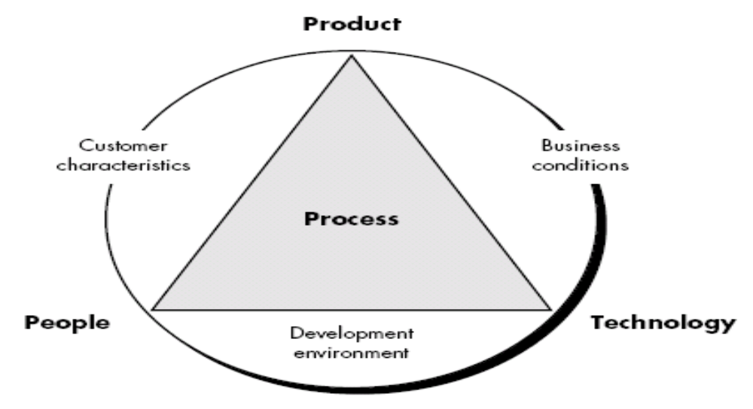
Process Metrics and Software Process Improvement

Slide 5
Process Metrics and Software Process Improvement
Process at the center connecting 3 factors that have a profound influence on software quality and organizational performance.
Process triangle exists within a circle of environmental conditions that include the development environment, business conditions and customer characteristics.
We measure the efficacy of a software process indirectly.
  That is, we derive a set of metrics based on the outcomes that can be derived from the process.
  Outcomes include
    measures of errors uncovered before release of the software
    defects delivered to and reported by end-users
    work products delivered (productivity)
    human effort expended
    calendar time expended
    schedule conformance
    other measures.
We also derive process metrics by measuring the characteristics of specific software engineering tasks.

Slide 6
Process Metrics Guidelines
Use common sense and organizational sensitivity when interpreting metrics data.
Provide regular feedback to the individuals and teams who collect measures and metrics.
Don’t use metrics to appraise individuals.
Work with practitioners and teams to set clear goals and metrics that will be used to achieve them.
Never use metrics to threaten individuals or teams.
Metrics data that indicate a problem area should not be considered “negative.” These data are merely an indicator for process improvement.
Don’t obsess on a single metric to the exclusion of other important metrics.

Slide 7
Project Metrics
Used to minimize the development schedule by making the adjustments necessary to avoid delays and mitigate potential problems and risks
Used to assess product quality on an ongoing basis and, when necessary, modify the technical approach to improve quality.
Every project should measure:
  Inputs—measures of the resources (e.g., people, tools) required to do the work.
  Outputs—measures of the deliverables or work products created during the software engineering process.
  Results—measures that indicate the effectiveness of the deliverables.

Slide 8
Software Measurement
Categories in 2 ways:
  Direct measure of the software process & Product
    E.g. Lines of code (LOC), execution speed, and defect)
  Indirect measures of the product that include functionality, complexity, efficiency, reliability, maintainability etc.
  Team A found : 342 errors
  Team B found : 184 errors
  It is depends on size or complexity of the projects.
Which team is more efficient ?

Slide 9
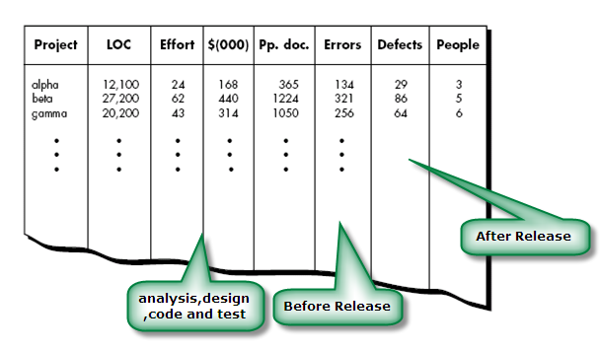
Size oriented metrics

Slide 10
Size-Oriented metrics
Size-oriented metrics measures on LOC as normalization value.
Errors per KLOC (thousand lines of code)
Defects per KLOC
$ per LOC
Pages of documentation per KLOC
Errors per person-month
Errors per review hour
LOC per person-month
$ per page of documentation

Slide 11
Function-Oriented Metrics
It use a measure of functionality delivered by the application as a normalization value.
Since ‘functionality’ cannot be measured directly, it must be derived indirectly using other direct measures
Function Point (FP) is widely used as function oriented metrics.
FP derived using an empirical relationship based on countable (direct) measures of software’s information domain and assessments of software complexity.
FP is based on characteristic of Software information domain and complexity.
Like LOC measure, FP is controversial.
FP is programming language independent.
It is ideal for applications using conventional and nonprocedural languages.

Slide 12
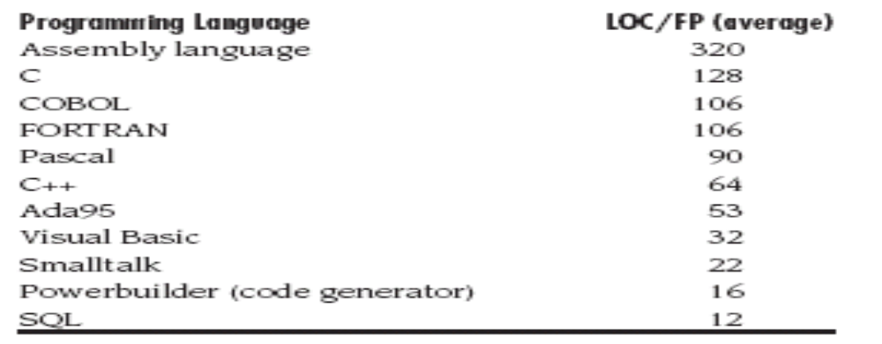
Reconciling LOC and FP metric
Relationship between lines of code and function points depends upon the programming language that is used to implement the software and the quality of the design.
Following table provides rough estimates of the average number of LOC required to build one FP in various programming languages:

